Slide 1
Music History
Timeline;
https://youtu.be/6JVq6gwIBOQ
century
actually
15th
16th
17th
5th
18th
19th
20th
Prehistory
Barroque
Classicism
Modern
Medium Age
Renasciment
Contemporary
movement

Slide 2
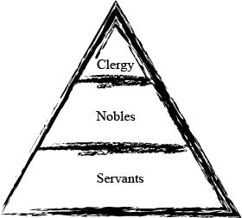
Medieval period
From 5th century to 15th century;
Fall of the Roman Empire;
Churchill Power;
Sacra music and Profane music;
Exchange-based commerce;

Slide 3
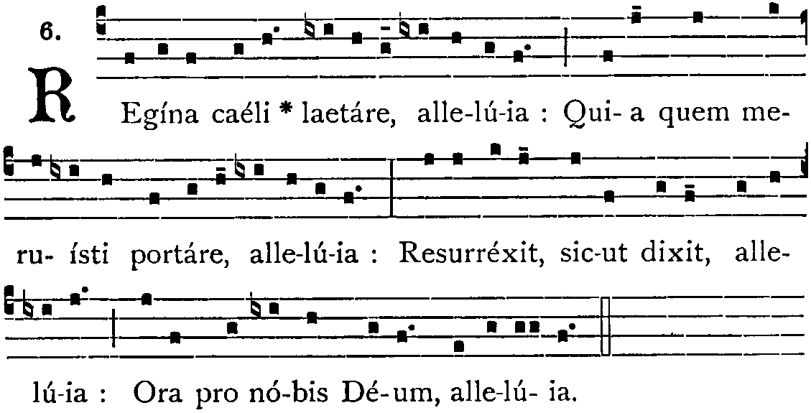
Gregorian chant
Monophonic;
Sacra Music;
Praise of God ;
Gregorio Magno;
Systematization, unification and popularization;

Slide 4
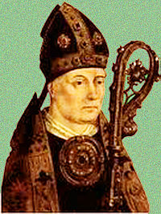
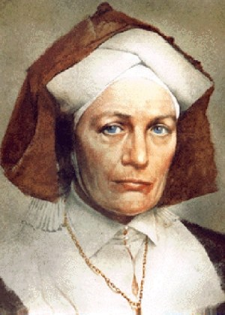
Composers
Philippe de Vitri;
Hildegard Von Bingen;
(1291 – 1361)
(1098 – 1170)
created Ars Nova;
Break preconception against woman.

Slide 5
Compositions monophonic
Adorate Deum;
Kyrie Eleison;
Symphonia armonie celestium revelationum;
Ordo Virtutum.
Male Voice
Hildegard Von Bingen

Slide 6
RENASCIMENT
From 16th century to 17th century;
Eliminate Medieval Period;
Eliminate the concept Heaven X Hell;
Study the Science as a whole;
Humanist;
Anthropocentrism;
Heliocentric;

Slide 7
Philosophers:
Artists:
Dante Alighieri;
Marquiavel;
Leonardo da Vinci;
Michelangelo;
Rafael;
Socrates;
Platan;
Aristotles;

Slide 8
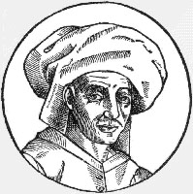
Josquin des préz
(1440/1521)
Nationality;
Infance;
Compositions;
Skills;
https://www.youtube.com/watch?v=usUEuuUcaSg

Slide 9
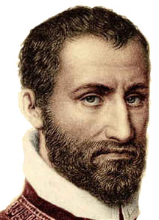
Giovanni da palestrina
(1525/1594)
Nationality;
Infance;
Compositions;
Skills;
https://www.youtube.com/watch?v=hyDRSI1joa8

Slide 10
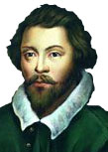
William byrd
(1542/1623)
Nationality;
Infance;
Compositions;
Skills;
https://www.youtube.com/watch?v=kIit-s9mlGQ

Slide 11
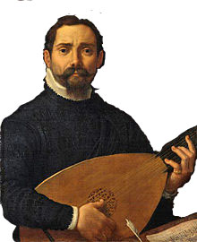
Giovanni gabrielli
(1555/1612)
Nationality;
Infance;
Compositions;
Skills;
https://www.youtube.com/watch?v=olIrf-uioD8

Slide 12
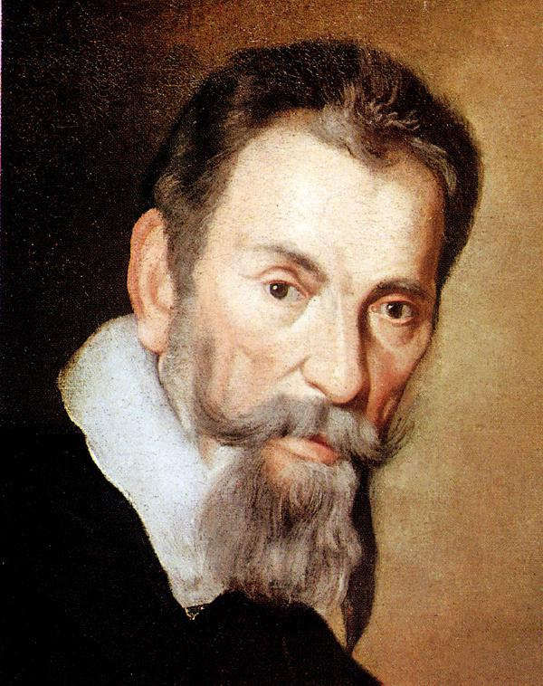
montiverdi
(1543/1643)
Nationality;
Infance;
Relationship;
Compositions;
Skills;
https://www.youtube.com/watch?v=LwxcYq5WEGA&index=4&list=PLvPSXMVWmy3cXQIPivoC9mLnaCg75bE4I

Slide 13
Baroque
From the 1600 to 1750 in Italy;
Absolutist regime and against Reform;
Catholic church defunded Baroque;
Polyphonic and creation canon;
Respecting the rhythmic musical or compass musical;

Slide 14
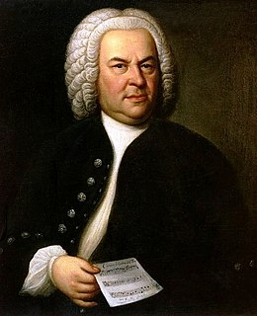
Bach
1685 - 1750
Nationality;
Infance;
Relationship;
Compositions;
Skills;
https://www.youtube.com/watch?v=rrVDATvUitA

Slide 15
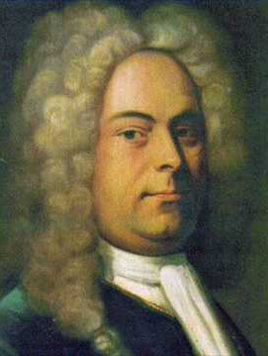
Haendel
1685 - 1759
Nationality;
Infance;
Relationship;
Compositions;
Skills
https://www.youtube.com/watch?v=rrVDATvUitA

Slide 16
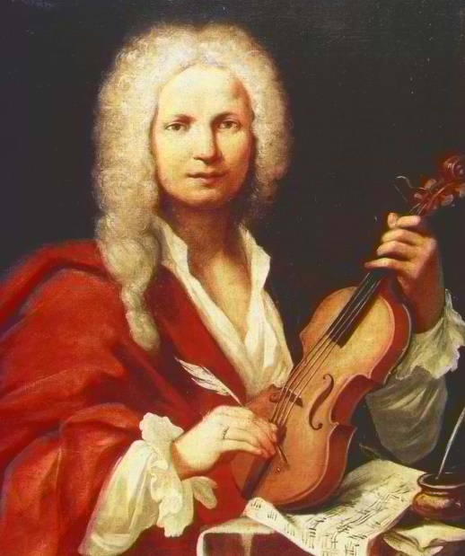
Vivaldi
1678 - 1741
Nationality;
Infance;
Relationship;
Compositions;
Skills
https://www.youtube.com/watch?v=rrVDATvUitA

Slide 17
Classicism
from the 18th century to 19th century in Europe;
French Revolution;
Change the spirit;
Transformation of Baroque music and Classicism;
Diversify the instruments;

Slide 18
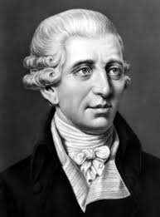
Haydn
1678 - 1741
Nationality;
Infance;
Relationship;
Compositions;
Skills
https://www.youtube.com/watch?v=TFcONi1ynIM

Slide 19
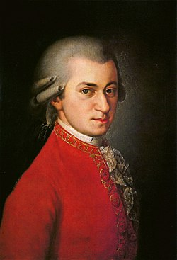
Mozart
1756 - 1791
Nationality;
Infance;
Relationship;
Compositions;
Skills
https://www.youtube.com/watch?v=YuBeBjqKSGQ

Slide 20
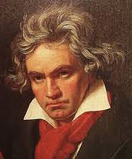
beethoven
1770 - 1827
Nationality;
Infance;
Relationship;
Compositions;
Skills
https://www.youtube.com/watch?v=ChygZLpJDNE

Slide 21
Romantism
from the 18th century to 19th century in Europe;
French Revolution;
Change the spirit;
Transformation of Baroque and Classicism music;
Diversify the instruments;
Urbanism X Countryside

Slide 22
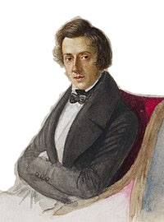
Chopin
1810 - 1849
Nationality;
Infance;
Relationship;
Compositions;
Skills;
https://www.youtube.com/watch?v=_5y2LUUwK3E

Slide 23
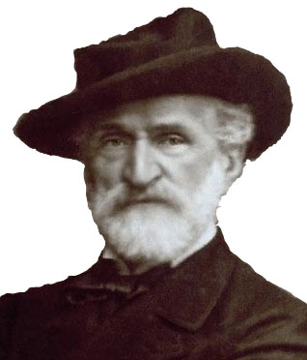
Verdi
1813 - 1901
Nationality;
Infance;
Relationship;
Compositions;
Skills
https://www.youtube.com/watch?v=AssDQbaIP_I

Slide 24
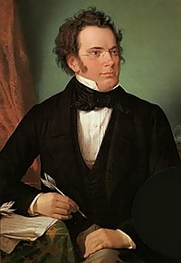
Schubert
1897 - 1928
Nationality;
Infance;
Relationship;
Compositions;
Skills
https://www.youtube.com/watch?v=PKUPBr0eY6Y

Slide 25
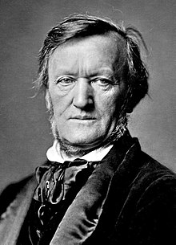
Wagner
1813 - 1883
Nationality;
Infance;
Relationship;
Compositions;
Skills
https://www.youtube.com/watch?v=GGU1P6lBW6Q

Slide 26
Wagner
1813 - 1883
Nationality;
Infance;
Relationship;
Compositions;
Skills
https://www.youtube.com/watch?v=GGU1P6lBW6Q

Slide 27
Modernism
From the 19th century to 20th century in Europe;
Conjunct of cultural movememt;
Definition;
Reality versus Subjective;
Initialy, in Brazil this movement
was not accepted;
Futurism;
Dadaism;
Cubism;
Surrealism;

Slide 28
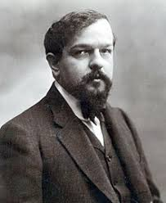
Debussy
1862 - 1918
Nationality;
Infance;
Relationship;
Compositions;
Skills
https://www.youtube.com/watch?v=CvFH_6DNRCY

Slide 29
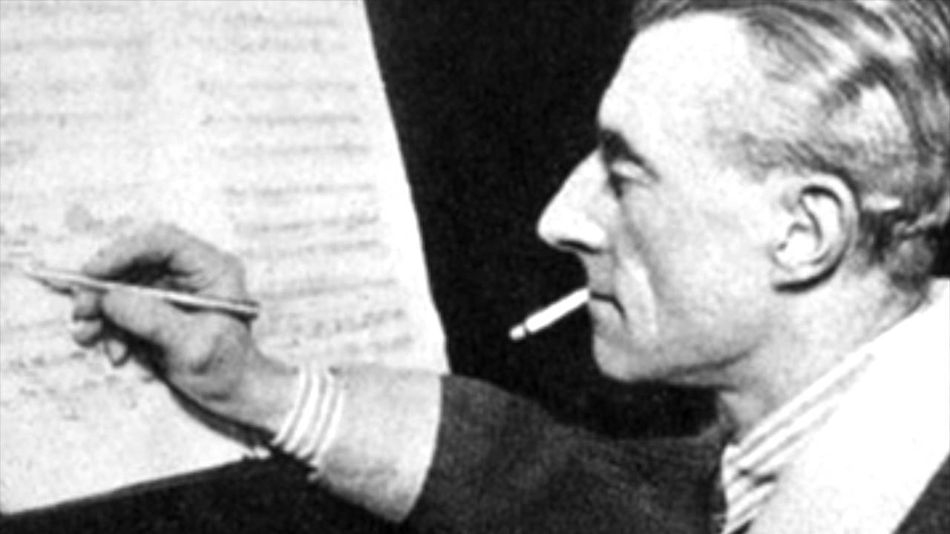
ravel
1875 - 1937
Nationality;
Infance;
Relationship;
Compositions;
Skills
https://www.youtube.com/watch?v=MTceaEzIPdY

Slide 30
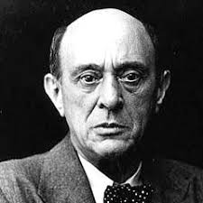
Schönberg
1874 - 1951
Nationality;
Infance;
Relationship;
Compositions;
Skills
https://www.youtube.com/watch?v=DFXkc9AGoeU

